Slide 1

Movie Recommendation System with PySpark
Kara Fallin, Aparna Marathe, Nick Pasternak
Notes:
make it more memorable
make it clear what the response variable is/problem
-challenges you ran into - how you solved them
what made it challenging

Slide 2






Executive Summary
How do we compare content-based and collaborative filtering approaches in the recommendation of movies based on predicted user ratings?
Our findings suggest that collaborative filtering with explicit preferences performed the best for recommending movies

Slide 3
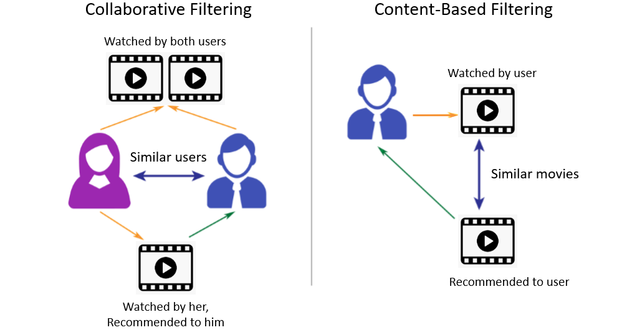
An Overview of Recommender Systems

Slide 4
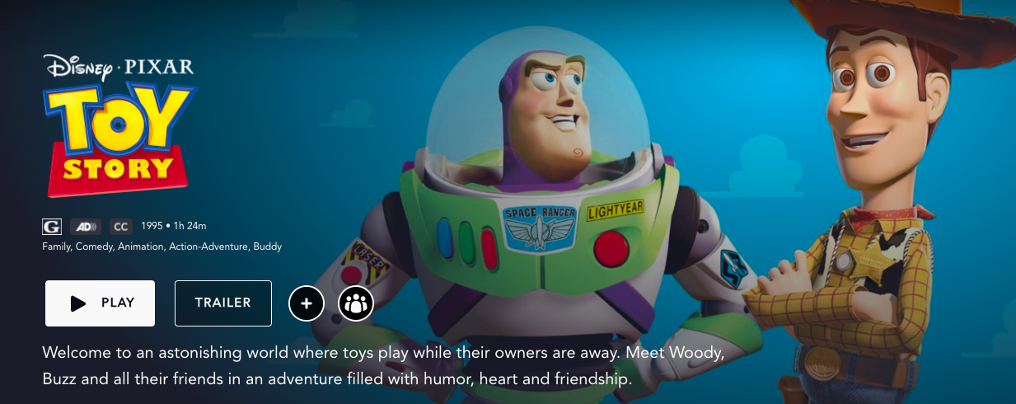

Data Description
Our dataset captures information from MovieLens, a movie recommendation service
Target variable is the explicit rating of the movie
Other features include user ID, movie ID, title, genre(s), release year, and IMDB ID
Web-scraped IMDB metadata to obtain movie category, IMDB score and movie description
Notes:
-predictors vary by model
→ collaborative: movie id, user id, rating,
→ content based: genre, year, category, score, description

Slide 5
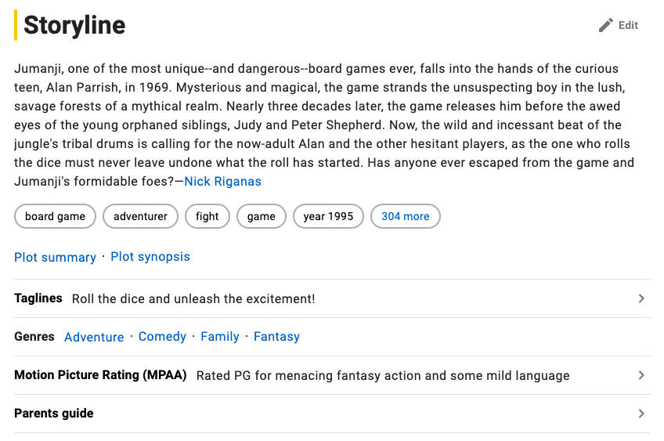
Variable Transformations and Preprocessing
Only necessary for content-based model:
Genres column was vectorized via TF-IDF
Category column was indexed and then vectorized via one-hot encoding
Description column was cleaned (converted to lowercase, removed punctuation and stop words) and then vectorized via TF-IDF after
Assembled features using VectorAssembler
Notes:
We had a lot of data and luckily most of it was clean even after web-scraping, but we still had to remove rows with null values and then sampled 1 million of the original 20 million for the actual model building process
After that we went into variable transformation which was not needed for the collaborative-based models since they only required variables that were already in the correct format
Preprocessing, however, was necessary for the content-based model, which utilized the movie metadata including release year, IMDB score, genres, category (whether it was pg, pg-13, or R), and short movie description
We converted the genres column into an array of strings and then vectorized via TF-IDF
We indexed the category column and then used one-hot encoding to vectorize it
We cleaned up the description column, removing punctuation and stop words, converting words to lowercase, and finally vectorizing via TF-IDF
Lastly we used VectorAssembler to group these features into one column to predict user rating

Slide 6
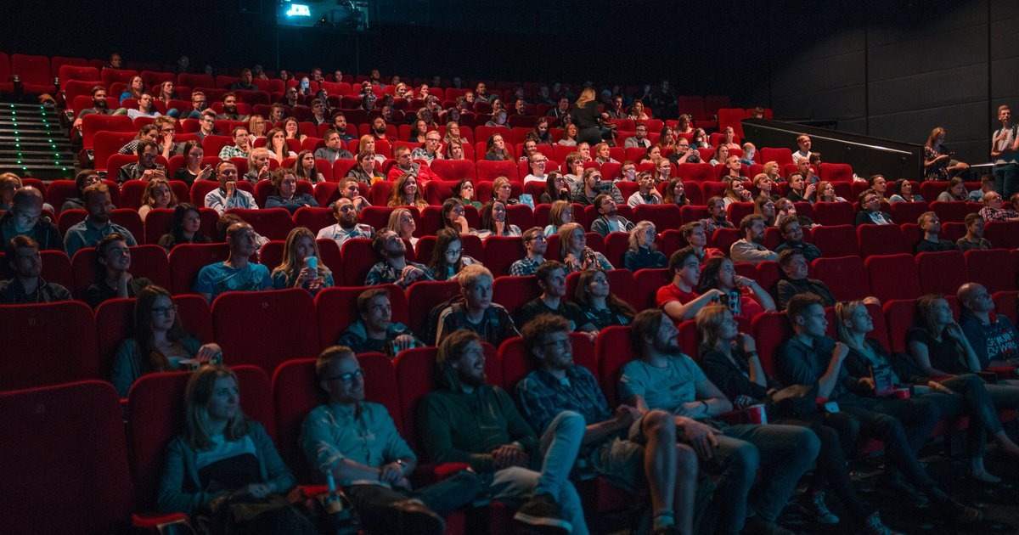
Models Constructed
Collaborative filtering - ALS
Explicit Preference
Implicit Preference
Content-based filtering - Linear Regression
Notes:
We constructed two collaborative filtering models that utilized the ALS algorithm for matrix factorization – one with explicit preferences (which used user ratings along with movie id and user id) and one with implicit preferences (which only relied on movie id and user id)
We also constructed a content-based linear regression model that predicted user ratings of movies based solely on movie metadata which I mentioned earlier
For the models we used a random 70/30 train-test split but ran into trouble with the content-based model since a random split would lead to movies being in both
we tried randomly splitting the data for training and testing, but this didn’t make sense since we were essentially training and then testing on movies that users had watched before; eventually, with the help of tashman, we found it made the most sense to split the training and testing sets so that no one movie would be in both

Slide 7
Model Performance: RMSE
Model | Score
ALS Explicit | 1.047
ALS Implicit | 3.636
Linear Regression (CB) | 1.079
Notes:
For each of the three models we ran 3-fold cross validation to tune/find the best model parameters and then used RMSE to evaluate the best models
The RMSE essentially tells us how close our predicted ratings were to the actual ratings
We ended up with the following results: as you can see, the ALS Explicit model performed the best, closely followed by the linear regression model, which was not so closely followed by the ALS Implicit model
We also took a qualitative approach to evaluating the models, which we’ll talk about next…

Slide 8
Model Performance: Qualitative Approach
Actual Preferences of User #318 vs. ALS Explicit Recommendations
Actual Preferences | Recommendations
Toy Story Terminator 2: Judgement Day The Good, The Bad, and The Ugly Monty Python’s Life of Brian Monty Python and the Holy Grail | Donnie Darko Irony of Fate, or Enjoy Your Bath! The Killing The War of the Worlds A Day in the Country
Notes:
We also opted to take a more qualitative approach in our model evaluation efforts
For each of the three models, we were able to generate a set of recommendations for every user.
We arbitrarily chose one specific user to see how our predictions compared to their actual preferences - which were the movies that they rated the highest
As you can see, this user’s actual preferences are all over the place - but include genres such as action, adventure, animation and comedy
Our explicit model did well in recommending movies with genres such as comedy and action

Slide 9
Model Performance: Qualitative Approach
Actual Preferences of User #318 vs. ALS Implicit Recommendations
Actual Preferences | Recommendations
Toy Story Terminator 2: Judgement Day The Good, The Bad, and The Ugly Monty Python’s Life of Brian Monty Python and the Holy Grail | The Lord of the Rings: The Two Towers Fight Club The Lord of the Rings: The Return of the King The Lord of the Rings: The Fellowship of the Ring Batman Begins
Notes:
Our implicit model recommended movies with genres that ranged from drama, action and thriller

Slide 10
Model Performance: Qualitative Approach
Actual Preferences of User #318 vs. Linear Regression Recommendations
Actual Preferences | Recommendations
Toy Story Terminator 2: Judgement Day The Good, The Bad, and The Ugly Monty Python’s Life of Brian Monty Python and the Holy Grail | The Notebook Slumdog Millionaire Batman Beyond: Return of the Joker Pan’s Labyrinth Hugo
Notes:
Our content based model yielded a range of genres that we felt most closely aligned the the user’s actual preferences - capturing movies that had themes of action, animation and adventure

Slide 11
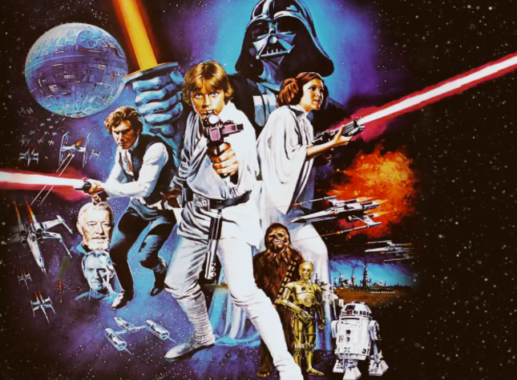
Conclusions and Future Research
Our RMSE values make sense (explicit vs. implicit)
Explicit collaborative filtering performed the best in terms of RMSE
Qualitative predictions suggest good performance of content-based model
Future Work:
Normalize reviews for content-based model
Try other factorization (i.e. SVD) instead of ALS
Collect and implement user information in content-based model
Notes:
Our best models yielded RMSE values of around 1, which is a pretty good score in the context of the range of the ratings that were included in the dataset
It makes sense that our implicit model did worse than our explicit, as it used less information
In terms of the RMSE, our collaborative filtering approach with explicit yielded the best score, but we would also like to note that the content-based model yielded a similar RMSE with pretty good movie predictions
In the future, we would hope to normalize the rating values rather than using the raw value itself - in cases where users were to rate every movie a 5, if we used a z-score rather than the raw value we would allow for users that rated each movie differently to be more important in our model
We would also like to use different approaches like SVD and incorporate user information into our content-based model

Slide 12
Sources
“Build a Movie Recommendation System on Your Own.” Analytics Vidhya, 24 Nov. 2020, https://www.analyticsvidhya.com/blog/2020/11/create-your-own-movie-movie-recommendation-system/.
Building a Movie Recommendation Engine Using Spark ALS. Binod Suman Academy, https://www.youtube.com/watch?v=EfHscLaMobY.
“Collaborative Filtering.” Collaborative Filtering - Spark 2.2.0 Documentation, https://spark.apache.org/docs/2.2.0/ml-collaborative-filtering.html.
“Content-Based Recommender Using Natural Language Processing (NLP).” KDnuggets, https://www.kdnuggets.com/2019/11/content-based-recommender-using-natural-language-processing-nlp.html.
“Fans Are Defying George Lucas and Watching This Version of Star Wars.” The Independent, Independent Digital News and Media, 17 Feb. 2016, https://www.independent.co.uk/arts-entertainment/films/news/star-wars-leak-1977-theatrical-release-hd-restoration-george-lucas-a6878866.html.
“Image.” Watch playin_details - Hungama Play, http://webview.hungama.com/play/playin_details/2111854/4//12019/seven/playin_details.
“Movielens.” GroupLens, 8 Dec. 2021, https://grouplens.org/datasets/movielens/.
Nair, Snehal. “PySpark Collaborative Filtering with ALS.” Medium, Towards Data Science, 8 Sept. 2020, https://towardsdatascience.com/build-recommendation-system-with-pyspark-using-alternating-least-squares-als-matrix-factorisation-ebe1ad2e7679.
“Ratings, Reviews, and Where to Watch the Best Movies & TV Shows.” IMDb, IMDb.com, https://www.imdb.com/.
“You Can Get a Workout by Watching a Movie – If You're at the Theater.” PhillyVoice, 13 Jan. 2020, https://www.phillyvoice.com/can-you-get-workout-watching-movie/.

